Slide 1
Decision Tree based Learning

Slide 2
ML Algorithms
There are three types of machine learning algorithms: supervised, unsupervised and reinforcement.
In supervised learning, the machine is taught by example.
- Classification and Regression
In unsupervised learning, the machine studies data to identify patterns
- Clustering and Dimensionality reduction
Reinforcement Learning(RL) is a type of machine learning technique that enables an agent to learn in an interactive environment by trial and error using feedback from its own actions and experiences.

Slide 3
Classification Algorithms can be further divided into the following types:
Logistic Regression
K-Nearest Neighbours
Support Vector Machines
Kernel SVM
Naïve Bayes
Decision Tree Classification
Random Forest Classification
Regression Algorithms can be further divided into the following types:
Simple Linear Regression
Multiple Linear Regression
Polynomial Regression
Support Vector Regression
Decision Tree Regression
Random Forest Regression

Slide 4
Decision Tree
A decision tree is a supervised learning algorithm, which is utilized for both classification (predict/Classify the discrete values) and regression tasks (predict/Classify the continuous values).
It is a hierarchical tree-structured algorithm that is used for derived a meaningful output from a variety of inputs. It consists of a root node, branches, internal nodes and leaf nodes.

Slide 5
Top-down induction of Decision Trees
ID3 (Quinlan, 1986) is a basic algorithm used to create DT’s
- ID3 stands for Iterative Dichotomiser 3 and is named such because the algorithm iteratively (repeatedly) dichotomizes(divides) features into two or more groups at each step.
The construction of the tree is top-down. The algorithm is greedy.
In construction of DT determining “which attribute should be tested next? Which attribute gives us more information?”, is important.
A descendent node is then created for each possible value of this attribute and data set is partitioned according to this value.
The process is repeated for each successor node until all the examples are classified correctly or there are no attributes left

Slide 6
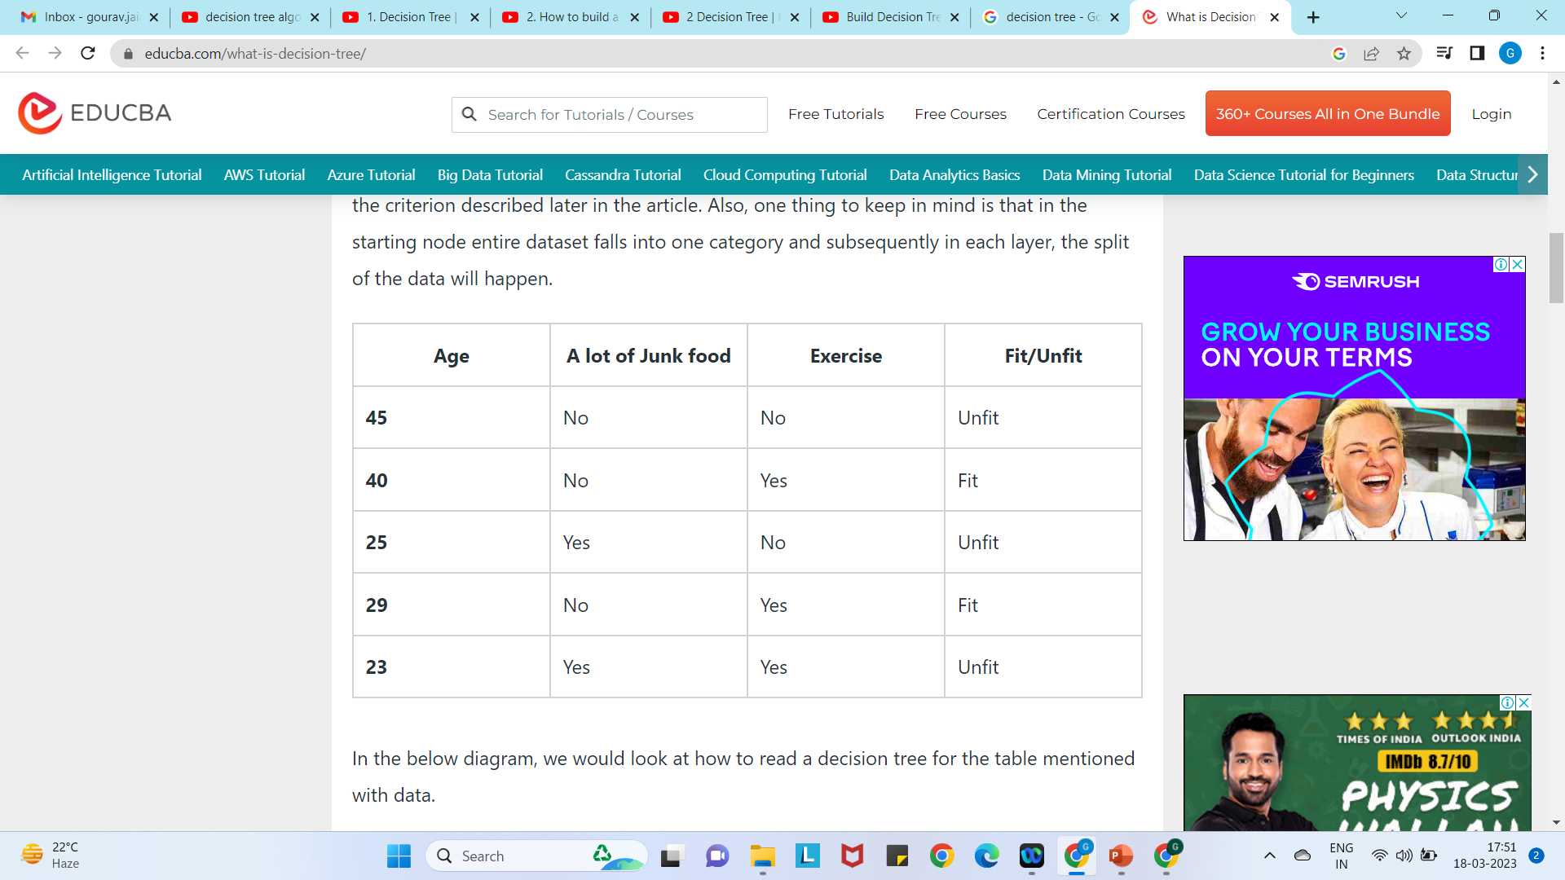
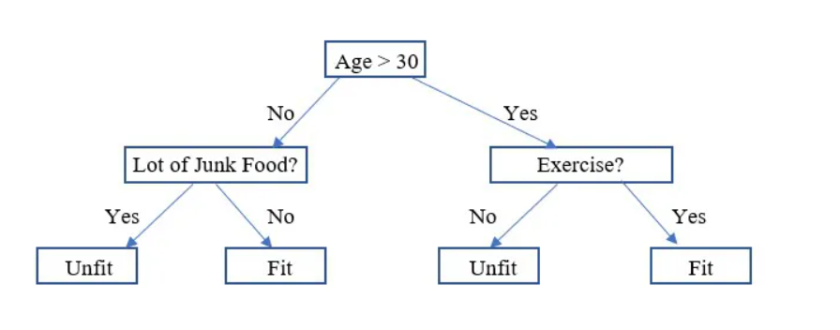
Decision tree to check person is fit or not.

Slide 7
Attribute Selection Measures
While implementing a Decision tree, the main issue arises that how to select the best attribute for the root node and for sub-nodes.
So, to solve such problems there is a technique which is called as Attribute selection measure or ASM.
By this measurement, we can easily select the best attribute for the nodes of the tree. There are two popular techniques for ASM, which are:
Information Gain/ ID3
Gini Index

Slide 8
Information Gain
Information Gain calculates the reduction in the entropy and measures how well a given feature separates or classifies the target classes. The feature with the highest Information Gain is selected as the best one.
Entropy measures the amount of information in a random variable

Slide 9
Information gain as entropy reduction
The higher the information gain the more effective the attribute
in classifying training data.
Gain(S, A) = Entropy(S) − Σ
|Sv|
Entropy(Sv)
|S|
v ∈ Values(A)
Sv subset of S for which A has value v

Slide 10
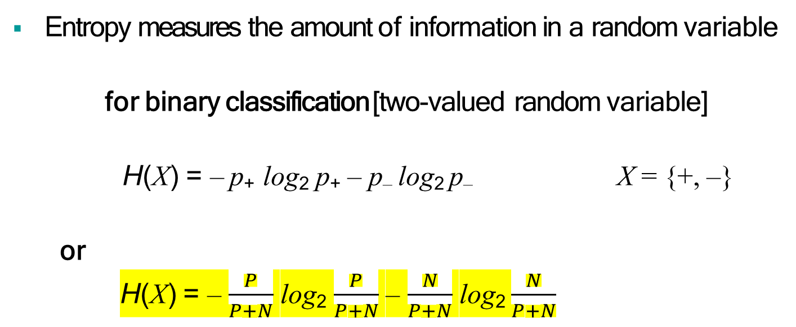
Entropy in general
Entropy measures the amount of information in a random variable
for binary classification [two-valued random variable]
H(X) = – p₊ log₂ p₊ – p– log₂ p– X = {+, –}
or
H(X) = – $\frac{P}{P+N}$ log₂ $\frac{P}{P+N}$ – $\frac{N}{P+N}$ log₂ $\frac{N}{P+N}$
for classification in c classes
_{c}
H(X) = – Σ p_{i} log₂ p_{i} = Σ p_{i} log₂ 1/ p_{i}
_{i=1}
X = {i, …, c}

Slide 11
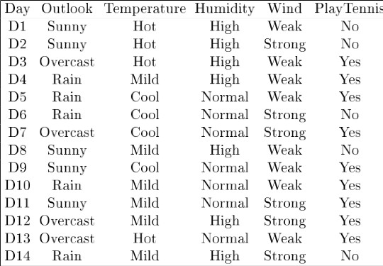
Example - 1

Slide 12
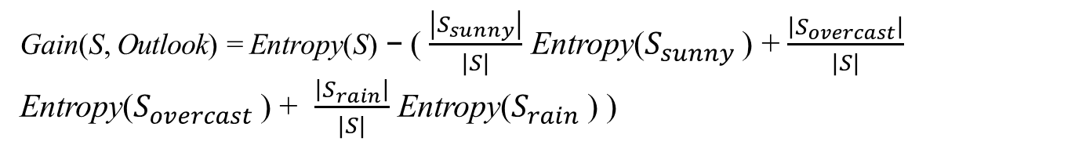

First Step is to choose the root node
For this, determine the Gain of each attribute with respect of target variable S.
Gain(S, A) = Entropy(S) − Σ$\frac{\left|S_{v}\right|}{|S|}$ Entropy(Sv)
v ∈ Values(A)
Gain(S, Outlook) = ? Values (Outlook) = Sunny, Overcast, Rain
Gain(S, Temp) = ? Values (Temp) = Hot. Cool, Mild
Gain(S, Humidity) = ? Values (Humidity) = High, Normal
Gain(S, Wind) = ? Values (Wind) = Weak, Strong
Where, S = Target Variable i.e. play tennis, A = Attributes i.e. Outlook, Humidity, Temp, Wind
Gain(S, Outlook) = Entropy(S) − ( $\frac{\left|S_{sunny}\right|}{|S|}$ Entropy($S_{sunny}$ ) + $\frac{\left|S_{overcast}\right|}{|S|}$ Entropy($S_{overcast}$ ) + $\frac{\left|S_{rain}\right|}{|S|}$ Entropy($S_{rain}$ ) )

Slide 13
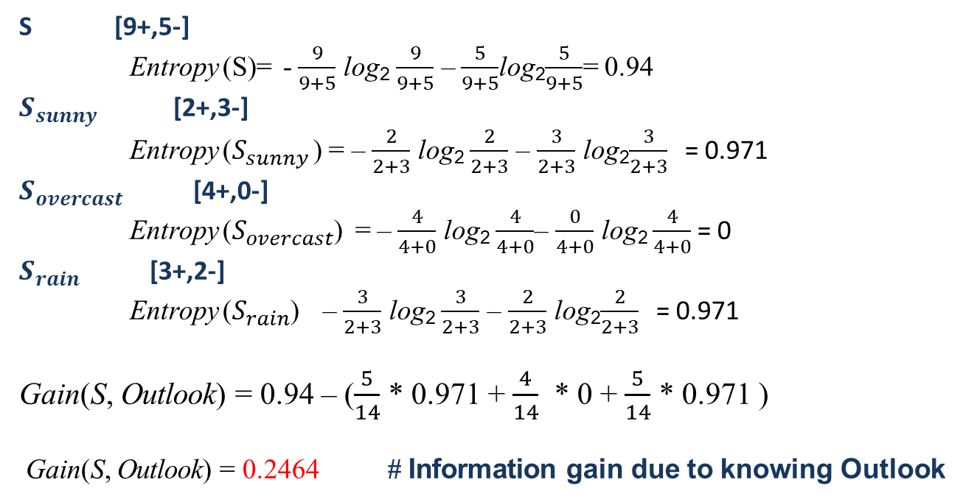

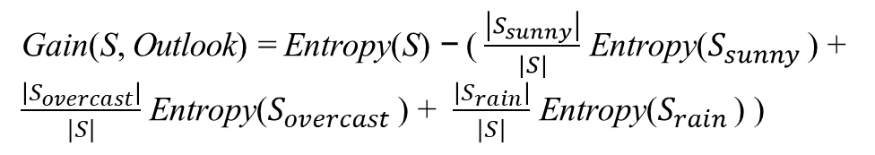
Gain(S, Outlook) = ? Attribute : Outlook Values= Sunny, Overcast, Rain
Gain(S, A) = Entropy(S) − Σ$\frac{\left|S_{v}\right|}{|S|}$ Entropy(Sv)
Gain(S, Outlook) = Entropy(S) − ( $\frac{\left|S_{sunny}\right|}{|S|}$ Entropy($S_{sunny}$ ) + $\frac{\left|S_{overcast}\right|}{|S|}$ Entropy($S_{overcast}$ ) + $\frac{\left|S_{rain}\right|}{|S|}$ Entropy($S_{rain}$ ) )
S [9+,5-]
Entropy (S)= - $\frac{9}{9+5}$ log₂ $\frac{9}{9+5}$ – $\frac{5}{9+5}$log₂$\frac{5}{9+5}$= 0.94
$S_{sunny}$ [2+,3-]
Entropy ($S_{sunny}$ ) = – $\frac{2}{2+3}$ log₂ $\frac{2}{2+3}$ – $\frac{3}{2+3}$ log₂$\frac{3}{2+3}$ = 0.971
$S_{overcast}$ [4+,0-]
Entropy ($S_{overcast}$) = – $\frac{4}{4+0}$ log₂ $\frac{4}{4+0}$– $\frac{0}{4+0}$ log₂ $\frac{4}{4+0}$= 0
$S_{rain}$ [3+,2-]
Entropy ($S_{rain}$) – $\frac{3}{2+3}$ log₂ $\frac{3}{2+3}$ – $\frac{2}{2+3}$ log₂$\frac{2}{2+3}$ = 0.971
Gain(S, Outlook) = 0.94 – ($\frac{5}{14}$ * 0.971 + $\frac{4}{14}$ * 0 + $\frac{5}{14}$ * 0.971 )
Gain(S, Outlook) = 0.2464 # Information gain due to knowing Outlook

Slide 14
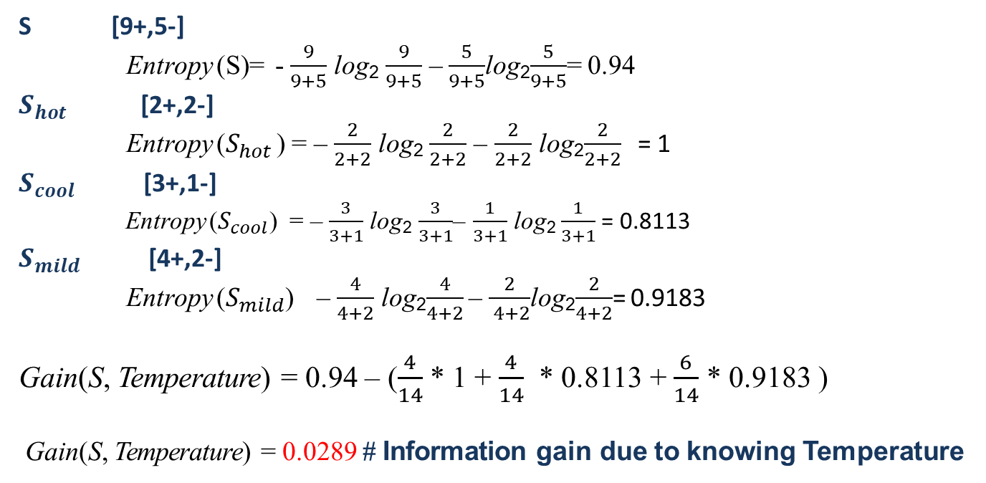
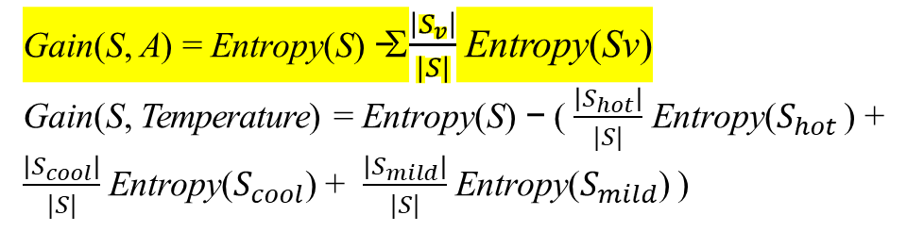
Gain(S, Temperature) = ? Attribute : Temperature Values= Hot, Cool, Mild
Gain(S, A) = Entropy(S) − Σ$\frac{\left|S_{v}\right|}{|S|}$ Entropy(Sv)
Gain(S, Temperature) = Entropy(S) − ( $\frac{\left|S_{hot}\right|}{|S|}$ Entropy($S_{hot}$ ) + $\frac{\left|S_{cool}\right|}{|S|}$ Entropy($S_{cool}$) + $\frac{\left|S_{mild}\right|}{|S|}$ Entropy($S_{mild}$) )
S [9+,5-]
Entropy (S)= - $\frac{9}{9+5}$ log₂ $\frac{9}{9+5}$ – $\frac{5}{9+5}$log₂$\frac{5}{9+5}$= 0.94
$S_{hot}$ [2+,2-]
Entropy ($S_{hot}$ ) = – $\frac{2}{2+2}$ log₂ $\frac{2}{2+2}$ – $\frac{2}{2+2}$ log₂$\frac{2}{2+2}$ = 1
$S_{cool}$ [3+,1-]
Entropy ($S_{cool}$) = – $\frac{3}{3+1}$ log₂ $\frac{3}{3+1}$– $\frac{1}{3+1}$ log₂ $\frac{1}{3+1}$= 0.8113
$S_{mild}$ [4+,2-]
Entropy ($S_{mild}$) – $\frac{4}{4+2}$ log₂$\frac{4}{4+2}$ – $\frac{2}{ 4+2}$log₂$\frac{2}{4+2}$= 0.9183
Gain(S, Temperature) = 0.94 – ($\frac{4}{14}$ * 1 + $\frac{4}{14}$ * 0.8113 + $\frac{6}{14}$ * 0.9183 )
Gain(S, Temperature) = 0.0289 # Information gain due to knowing Temperature

Slide 15
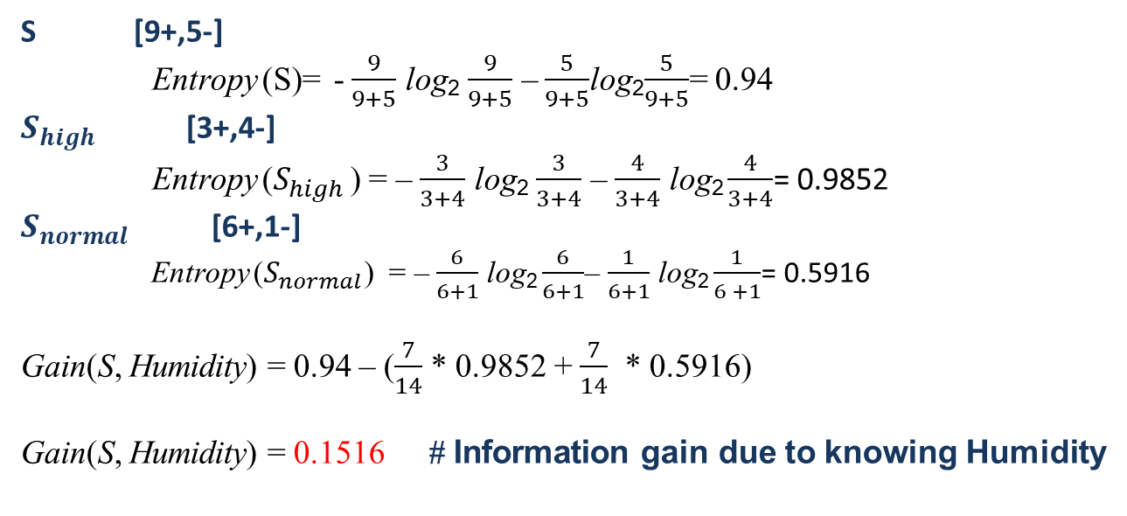
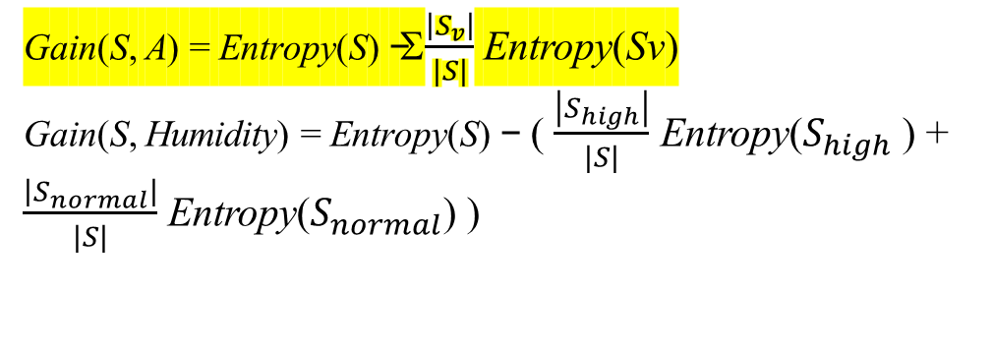
Gain(S, Humidity) = ? Attribute : Humidity Values= High, Normal
Gain(S, A) = Entropy(S) − Σ$\frac{\left|S_{v}\right|}{|S|}$ Entropy(Sv)
Gain(S, Humidity) = Entropy(S) − ( $\frac{\left|S_{high}\right|}{|S|}$ Entropy($S_{high}$ ) + $\frac{\left|S_{normal}\right|}{|S|}$ Entropy($S_{normal}$) )
S [9+,5-]
Entropy (S)= - $\frac{9}{9+5}$ log₂ $\frac{9}{9+5}$ – $\frac{5}{9+5}$log₂$\frac{5}{9+5}$= 0.94
$S_{high}$ [3+,4-]
Entropy ($S_{high}$ ) = – $\frac{3}{3+4}$ log₂ $\frac{3}{3+4}$ – $\frac{4}{3+4}$ log₂ $\frac{4}{3+4}$= 0.9852
$S_{normal}$ [6+,1-]
Entropy ($S_{normal}$) = – $\frac{6}{6+1}$ log₂ $\frac{6}{6+1}$– $\frac{1}{6+1}$ log₂ $\frac{1}{6 +1}$= 0.5916
Gain(S, Humidity) = 0.94 – ($\frac{7}{14}$ * 0.9852 + $\frac{7}{14}$ * 0.5916)
Gain(S, Humidity) = 0.1516 # Information gain due to knowing Humidity

Slide 16
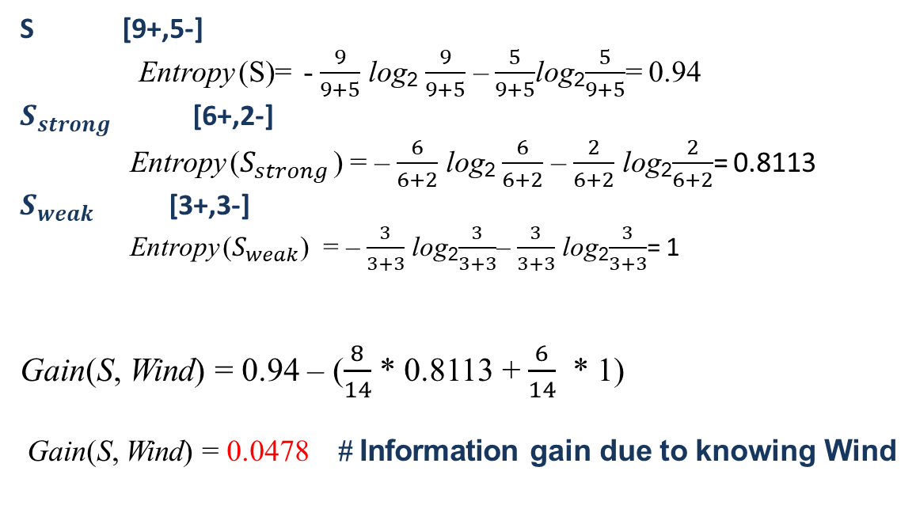
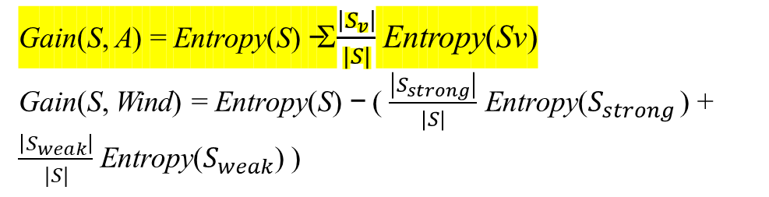
Gain(S, Wind) = ? Attribute : Wind Values= Strong, Weak
Gain(S, A) = Entropy(S) − Σ$\frac{\left|S_{v}\right|}{|S|}$ Entropy(Sv)
Gain(S, Wind) = Entropy(S) − ( $\frac{\left|S_{strong}\right|}{|S|}$ Entropy($S_{strong}$ ) + $\frac{\left|S_{weak}\right|}{|S|}$ Entropy($S_{weak}$) )
S [9+,5-]
Entropy (S)= - $\frac{9}{9+5}$ log₂ $\frac{9}{9+5}$ – $\frac{5}{9+5}$log₂$\frac{5}{9+5}$= 0.94
$S_{strong}$ [6+,2-]
Entropy ($S_{strong}$ ) = – $\frac{6}{6+2}$ log₂ $\frac{6}{6+2}$ – $\frac{2}{6+2}$ log₂$\frac{2}{6+2}$= 0.8113
$S_{weak}$ [3+,3-]
Entropy ($S_{weak}$) = – $\frac{3}{3+3}$ log₂$\frac{3}{3+3}$– $\frac{3}{3+3}$ log₂$\frac{3}{3+3}$= 1
Gain(S, Wind) = 0.94 – ($\frac{8}{14}$ * 0.8113 + $\frac{6}{14}$ * 1)
Gain(S, Wind) = 0.0478 # Information gain due to knowing Wind

Slide 17
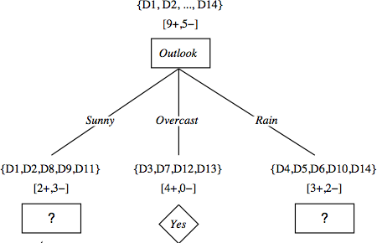
After first step
Gain(S, Outlook) = 0.2464 #Outlook provides the best prediction for the target
Gain(S, Temp) = 0.0289
Gain(S, Humidity) = 0.1516
Gain(S, Wind) = 0.0478

Slide 18
Lets grow the tree:
add to the tree a successor for each possible value of Outlook
partition the training samples according to the value of Outlook
For this, determine the information gain of sunny and rain due to temp, humidity and wind
Working on Outlook=Sunny node:
Gain(S_{Sunny}, Humidity) = ?
Gain(S_{Sunny}, Wind) = ?
Gain(S_{Sunny}, Temp.) = ?
Working on Outlook=Rain node:
Gain(S_{rain}, Humidity) = ?
Gain(S_{rain}, Wind) = ?
Gain(S_{rain}, Temp.) = ?

Slide 19
Day | Temperature | Humidity | Wind | Play Tennis
D1 | Hot | High | Weak | No
D2 | Hot | High | Strong | No
D8 | Mild | High | Weak | No
D9 | Cool | Normal | Weak | Yes
D11 | Mild | Normal | Strong | Yes
Gain(S_{Sunny}, A) = Entropy(S_{Sunny}) − Σ$\frac{\left|S_{v}\right|}{|\text{S}\text{S}\text{u}\text{n}\text{n}\text{y}|}$ Entropy(Sv)
Where A = Temperature, Humidity, Wind
Values (Temperature) = Hot, Mild, Cool
Values(Humidity) = High, Normal
Values(Wind) = Weak, Strong

Slide 20
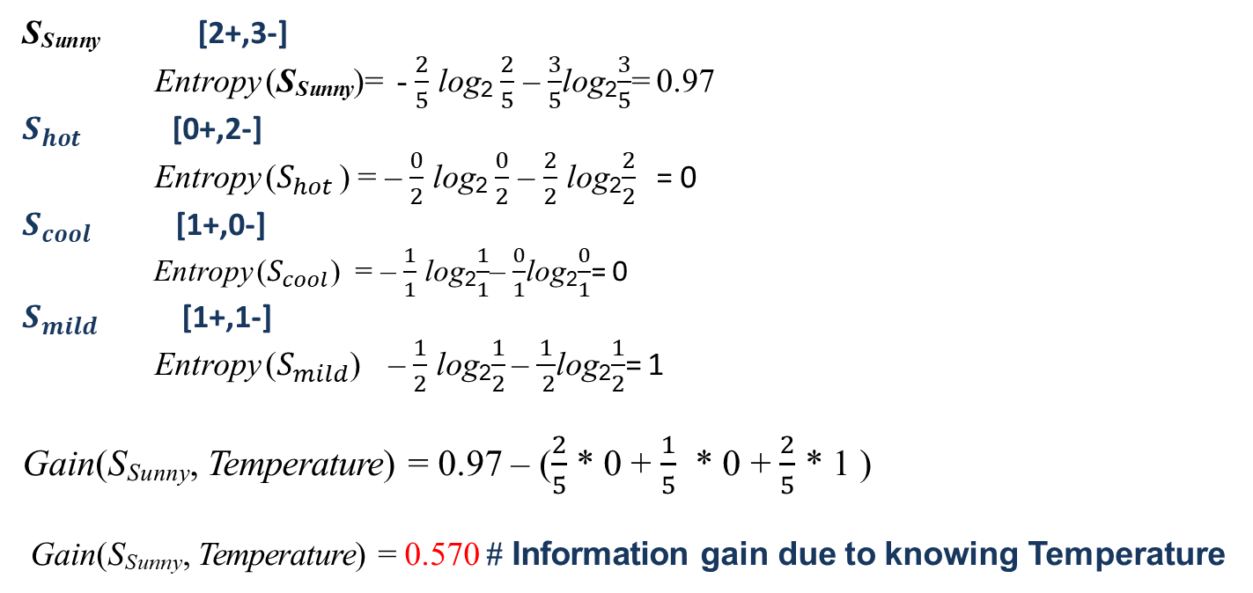
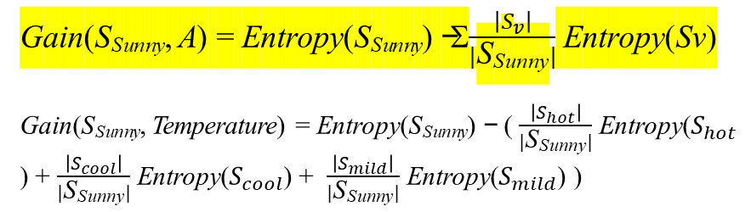
Gain(S_{Sunny}, Temperature) = ? Attribute : Temperature Values= Hot, Cool, Mild
Gain(S_{Sunny}, A) = Entropy(S_{Sunny}) − Σ$\frac{\left|S_{v}\right|}{|\text{S}\text{S}\text{u}\text{n}\text{n}\text{y}|}$ Entropy(Sv)
Gain(S_{Sunny}, Temperature) = Entropy(S_{Sunny}) − ( $\frac{\left|S_{hot}\right|}{|\text{S}\text{S}\text{u}\text{n}\text{n}\text{y}|}$ Entropy($S_{hot}$ ) + $\frac{\left|S_{cool}\right|}{|\text{S}\text{S}\text{u}\text{n}\text{n}\text{y}|}$ Entropy($S_{cool}$) + $\frac{\left|S_{mild}\right|}{|\text{S}\text{S}\text{u}\text{n}\text{n}\text{y}|}$ Entropy($S_{mild}$) )
Day | Temperature | Humidity | Wind | Play Tennis
D1 | Hot | High | Weak | No
D2 | Hot | High | Strong | No
D8 | Mild | High | Weak | No
D9 | Cool | Normal | Weak | Yes
D11 | Mild | Normal | Strong | Yes
S_{Sunny} [2+,3-]
Entropy (S_{Sunny})= - $\frac{2}{5}$ log₂ $\frac{2}{5}$ – $\frac{3}{5}$log₂$\frac{3}{5}$= 0.97
$S_{hot}$ [0+,2-]
Entropy ($S_{hot}$ ) = – $\frac{0}{2}$ log₂ $\frac{0}{2}$ – $\frac{2}{2}$ log₂$\frac{2}{2}$ = 0
$S_{cool}$ [1+,0-]
Entropy ($S_{cool}$) = – $\frac{1}{1}$ log₂$\frac{1}{1}$– $\frac{0}{1}$log₂$\frac{0}{1}$= 0
$S_{mild}$ [1+,1-]
Entropy ($S_{mild}$) – $\frac{1}{2}$ log₂$\frac{1}{2}$ – $\frac{1}{ 2}$log₂$\frac{1}{2}$= 1
Gain($\text{S}\text{S}\text{u}\text{n}\text{n}\text{y}$, Temperature) = 0.97 – ($\frac{2}{5}$ * 0 + $\frac{1}{5}$ * 0 + $\frac{2}{5}$ * 1 )
Gain($\text{S}\text{S}\text{u}\text{n}\text{n}\text{y}$, Temperature) = 0.570 # Information gain due to knowing Temperature

Slide 21
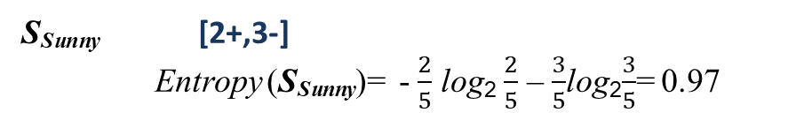
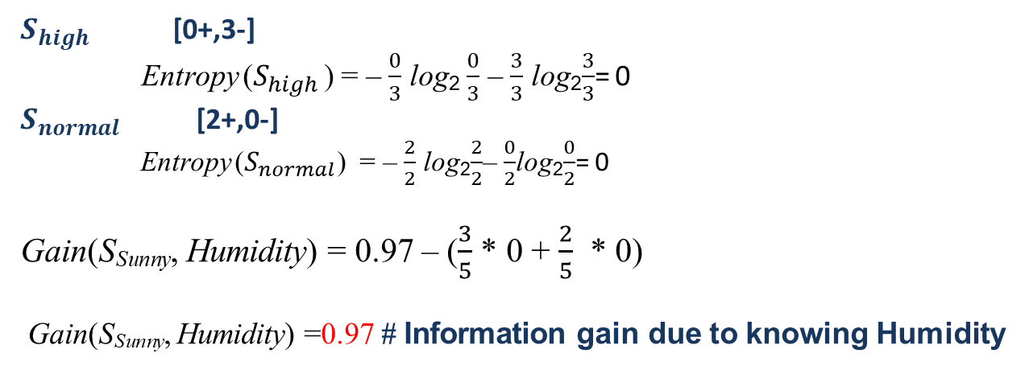
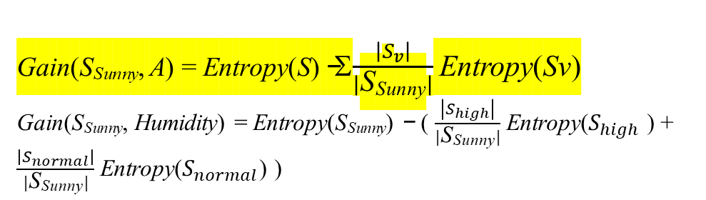
Gain(S_{Sunny}, Humidity) = ? Attribute : Humidity Values= High, Normal
Day | Temperature | Humidity | Wind | Play Tennis
D1 | Hot | High | Weak | No
D2 | Hot | High | Strong | No
D8 | Mild | High | Weak | No
D9 | Cool | Normal | Weak | Yes
D11 | Mild | Normal | Strong | Yes
Gain(S_{Sunny}, A) = Entropy(S) − Σ$\frac{\left|S_{v}\right|}{|\text{S}\text{S}\text{u}\text{n}\text{n}\text{y}|}$ Entropy(Sv)
Gain(S_{Sunny}, Humidity) = Entropy(S_{Sunny}) − ( $\frac{\left|S_{high}\right|}{|\text{S}\text{S}\text{u}\text{n}\text{n}\text{y}|}$ Entropy($S_{high}$ ) + $\frac{\left|S_{normal}\right|}{|\text{S}\text{S}\text{u}\text{n}\text{n}\text{y}|}$ Entropy($S_{normal}$) )
S_{Sunny} [2+,3-]
Entropy (S_{Sunny})= - $\frac{2}{5}$ log₂ $\frac{2}{5}$ – $\frac{3}{5}$log₂$\frac{3}{5}$= 0.97
$S_{high}$ [0+,3-]
Entropy ($S_{high}$ ) = – $\frac{0}{3}$ log₂ $\frac{0}{3}$ – $\frac{3}{3}$ log₂$\frac{3}{3}$= 0
$S_{normal}$ [2+,0-]
Entropy ($S_{normal}$) = – $\frac{2}{2}$ log₂$\frac{2}{2}$– $\frac{0}{2}$log₂$\frac{0}{2}$= 0
Gain(S_{Sunny}, Humidity) = 0.97 – ($\frac{3}{5}$ * 0 + $\frac{2}{5}$ * 0)
Gain(S_{Sunny}, Humidity) =0.97 # Information gain due to knowing Humidity

Slide 22
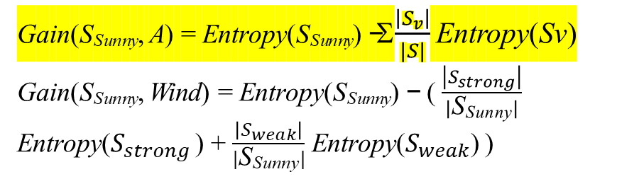
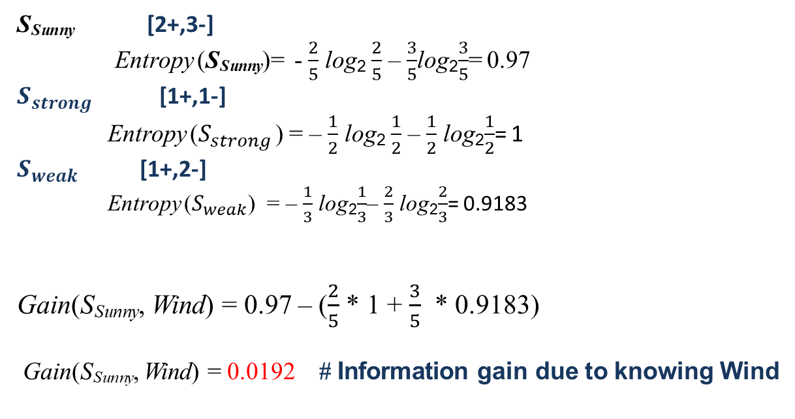
Gain(S_{Sunny}, Wind) = ? Attribute : Wind Values= Strong, Weak
Day | Temperature | Humidity | Wind | Play Tennis
D1 | Hot | High | Weak | No
D2 | Hot | High | Strong | No
D8 | Mild | High | Weak | No
D9 | Cool | Normal | Weak | Yes
D11 | Mild | Normal | Strong | Yes
Gain(S_{Sunny}, A) = Entropy(S_{Sunny}) − Σ$\frac{\left|S_{v}\right|}{|S|}$ Entropy(Sv)
Gain(S_{Sunny}, Wind) = Entropy(S_{Sunny}) − ( $\frac{\left|S_{strong}\right|}{|\text{S}\text{S}\text{u}\text{n}\text{n}\text{y}|}$ Entropy($S_{strong}$ ) + $\frac{\left|S_{weak}\right|}{|\text{S}\text{S}\text{u}\text{n}\text{n}\text{y}|}$ Entropy($S_{weak}$) )
S_{Sunny} [2+,3-]
Entropy (S_{Sunny})= - $\frac{2}{5}$ log₂ $\frac{2}{5}$ – $\frac{3}{5}$log₂$\frac{3}{5}$= 0.97
$S_{strong}$ [1+,1-]
Entropy ($S_{strong}$ ) = – $\frac{1}{2}$ log₂ $\frac{1}{2}$ – $\frac{1}{2}$ log₂$\frac{1}{2}$= 1
$S_{weak}$ [1+,2-]
Entropy ($S_{weak}$) = – $\frac{1}{3}$ log₂$\frac{1}{3}$– $\frac{2}{3}$ log₂$\frac{2}{3}$= 0.9183
Gain(S_{Sunny}, Wind) = 0.97 – ($\frac{2}{5}$ * 1 + $\frac{3}{5}$ * 0.9183)
Gain(S_{Sunny}, Wind) = 0.0192 # Information gain due to knowing Wind
S_{Sunny}

Slide 23
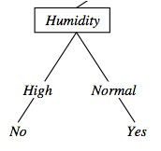
After Second Step
Working on Outlook=Sunny node:
Gain(S_{Sunny}, Humidity) = 0.97
Gain(S_{Sunny}, Wind) = 0.0192
Gain(S_{Sunny}, Temp.) = 0.570
{D1, D2, D8}
No
{D9, D11}
Yes

Slide 24
Day | Temperature | Humidity | Wind | Play Tennis
D4 | Mild | High | Weak | Yes
D5 | Cool | Normal | Weak | Yes
D6 | Cool | Normal | strong | No
D10 | Mild | Normal | Weak | Yes
D14 | Mild | High | Strong | No
Gain(S_{rain}, A) = Entropy(S_{rain}) − Σ$\frac{\left|S_{v}\right|}{|\text{S}\text{rain}|}$ Entropy(Sv)
Where A = Temperature, Humidity, Wind
Values (Temperature) = Hot, Mild, Cool
Values(Humidity) = High, Normal
Values(Wind) = Weak, Strong
Working on Outlook=Rain node:
Gain(S_{rain}, Humidity) = ?
Gain(S_{rain}, Wind) = ?
Gain(S_{rain}, Temp.) = ?

Slide 25
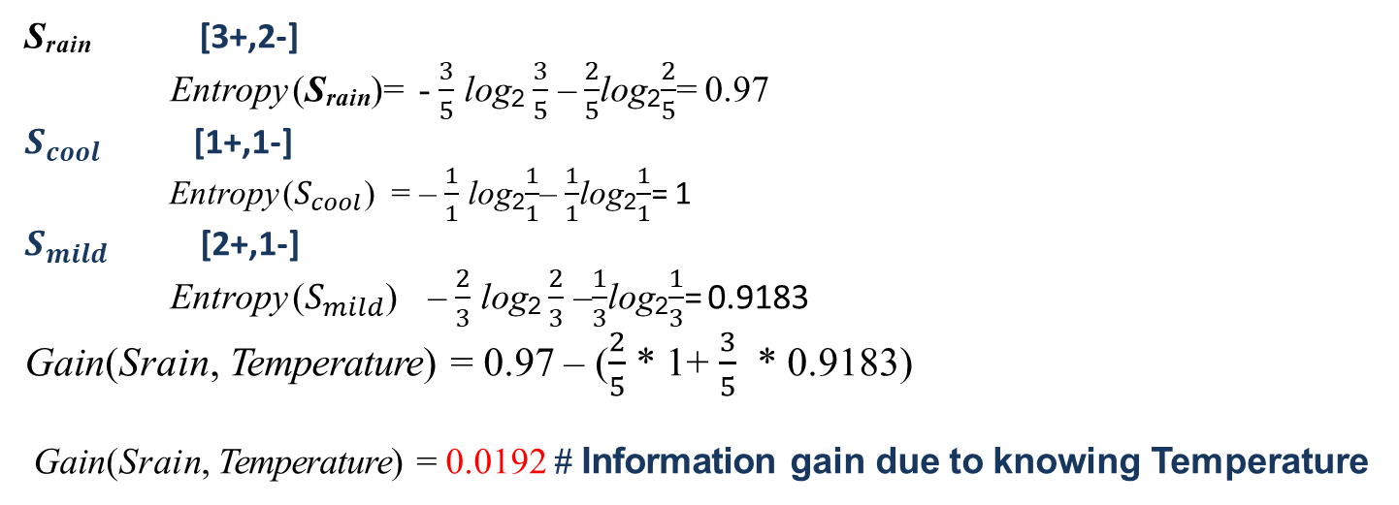
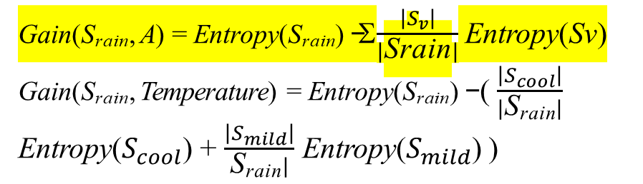
Gain(S_{rain}, Temperature) = ? Attribute : Temperature Values= Cool, Mild
Gain(S_{rain}, A) = Entropy(S_{rain}) − Σ$\frac{\left|S_{v}\right|}{|\text{S}\text{rain}|}$ Entropy(Sv)
Gain(S_{rain}, Temperature) = Entropy(S_{rain}) − ( $\frac{\left|S_{cool}\right|}{|\text{S}\text{rain}|}$ Entropy($S_{cool}$) + $\frac{\left|S_{mild}\right|}{\text{S}\text{rain}|}$ Entropy($S_{mild}$) )
Day | Temperature | Humidity | Wind | Play Tennis
D4 | Mild | High | Weak | Yes
D5 | Cool | Normal | Weak | Yes
D6 | Cool | Normal | strong | No
D10 | Mild | Normal | Weak | Yes
D14 | Mild | High | Strong | No
S_{rain} [3+,2-]
Entropy (S_{rain})= - $\frac{3}{5}$ log₂ $\frac{3}{5}$ – $\frac{2}{5}$log₂$\frac{2}{5}$= 0.97
$S_{cool}$ [1+,1-]
Entropy ($S_{cool}$) = – $\frac{1}{1}$ log₂$\frac{1}{1}$– $\frac{1}{1}$log₂$\frac{1}{1}$= 1
$S_{mild}$ [2+,1-]
Entropy ($S_{mild}$) – $\frac{2}{3}$ log₂ $\frac{2}{3}$ –$\frac{1}{3}$log₂$\frac{1}{3}$= 0.9183
Gain($\text{S}\text{rain}$, Temperature) = 0.97 – ($\frac{2}{5}$ * 1+ $\frac{3}{5}$ * 0.9183)
Gain($\text{S}\text{rain}$, Temperature) = 0.0192 # Information gain due to knowing Temperature

Slide 26
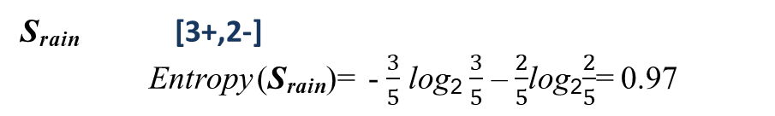
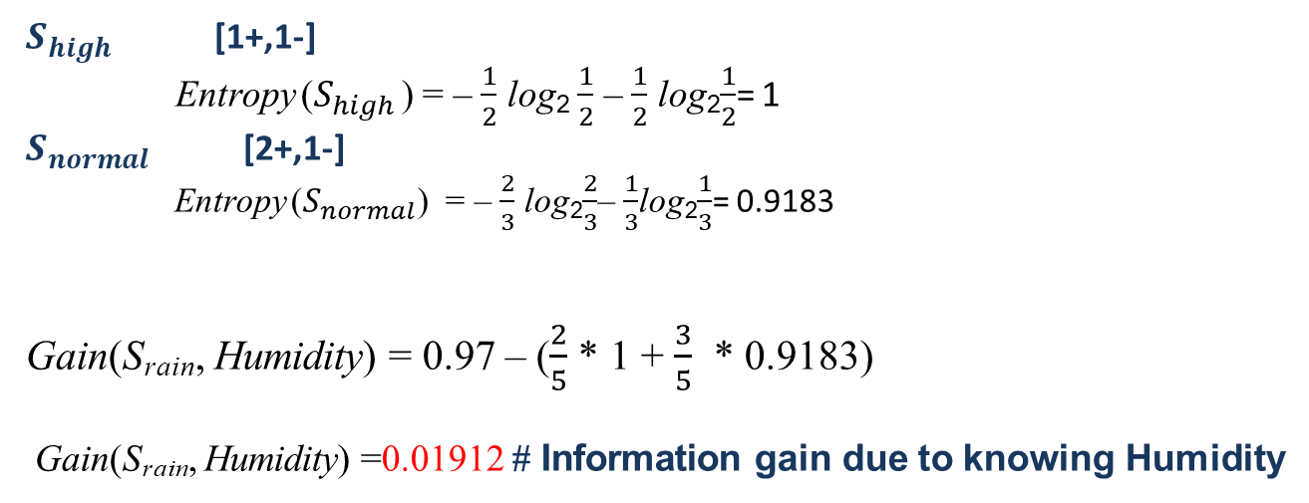
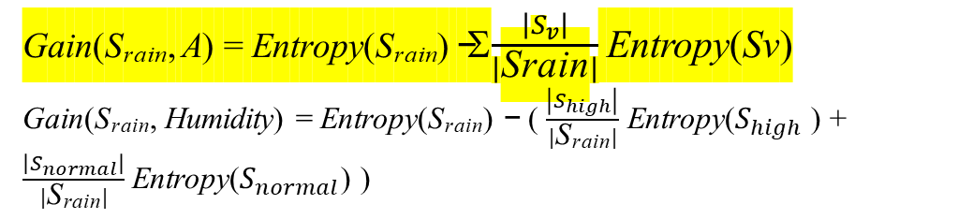
Gain(S_{rain}, Humidity) = ? Attribute : Humidity Values= High, Normal
Gain(S_{rain}, A) = Entropy(S_{rain}) − Σ$\frac{\left|S_{v}\right|}{|\text{Srain}|}$ Entropy(Sv)
Gain(S_{rain}, Humidity) = Entropy(S_{rain}) − ( $\frac{\left|S_{high}\right|}{|\text{S}\text{rain}|}$ Entropy($S_{high}$ ) + $\frac{\left|S_{normal}\right|}{|\text{S}\text{rain}|}$ Entropy($S_{normal}$) )
Day | Temperature | Humidity | Wind | Play Tennis
D4 | Mild | High | Weak | Yes
D5 | Cool | Normal | Weak | Yes
D6 | Cool | Normal | Strong | No
D10 | Mild | Normal | Weak | Yes
D14 | Mild | High | Strong | No
S_{rain} [3+,2-]
Entropy (S_{rain})= - $\frac{3}{5}$ log₂ $\frac{3}{5}$ – $\frac{2}{5}$log₂$\frac{2}{5}$= 0.97
$S_{high}$ [1+,1-]
Entropy ($S_{high}$ ) = – $\frac{1}{2}$ log₂ $\frac{1}{2}$ – $\frac{1}{2}$ log₂$\frac{1}{2}$= 1
$S_{normal}$ [2+,1-]
Entropy ($S_{normal}$) = – $\frac{2}{3}$ log₂$\frac{2}{3}$– $\frac{1}{3}$log₂$\frac{1}{3}$= 0.9183
Gain(S_{rain}, Humidity) = 0.97 – ($\frac{2}{5}$ * 1 + $\frac{3}{5}$ * 0.9183)
Gain(S_{rain}, Humidity) =0.01912 # Information gain due to knowing Humidity

Slide 27
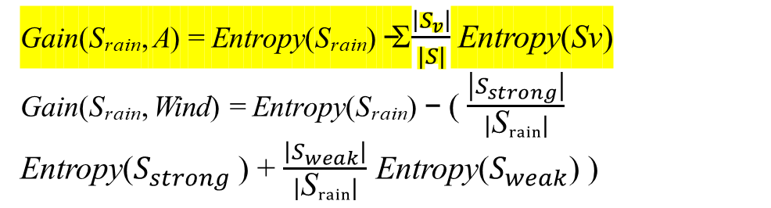
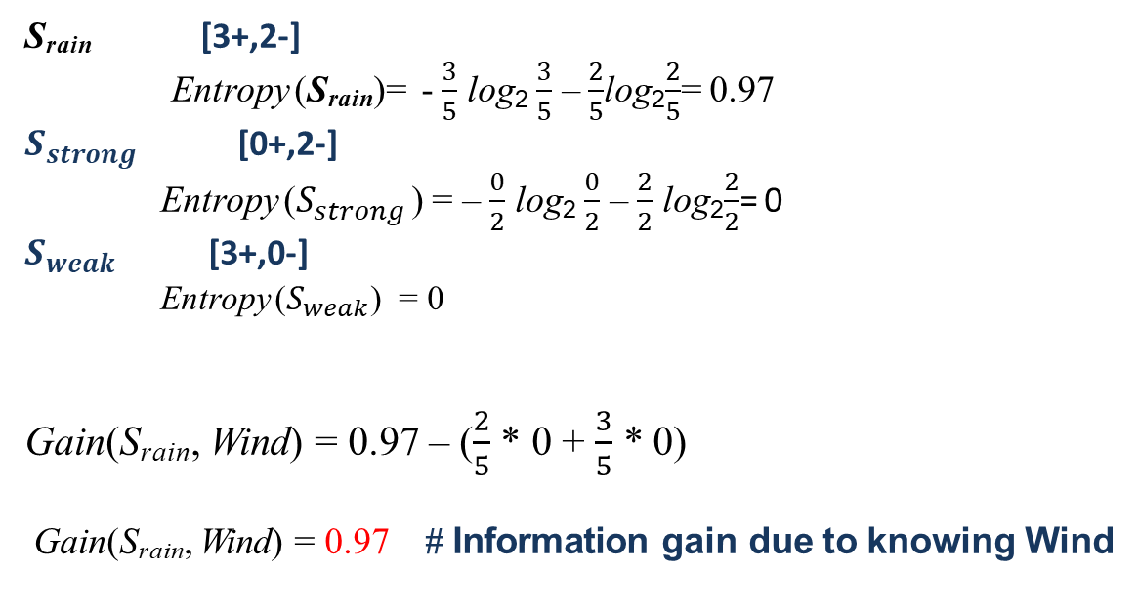
Gain(S_{rain}, Wind) = ? Attribute : Wind Values= Strong, Weak
Day | Temperature | Humidity | Wind | Play Tennis
D4 | Mild | High | Weak | Yes
D5 | Cool | Normal | Weak | Yes
D6 | Cool | Normal | Strong | No
D10 | Mild | Normal | Weak | Yes
D14 | Mild | High | Strong | No
Gain(S_{rain}, A) = Entropy(S_{rain}) − Σ$\frac{\left|S_{v}\right|}{|S|}$ Entropy(Sv)
Gain(S_{rain}, Wind) = Entropy(S_{rain}) − ( $\frac{\left|S_{strong}\right|}{|\text{S}rain|}$ Entropy($S_{strong}$ ) + $\frac{\left|S_{weak}\right|}{|\text{S}rain|}$ Entropy($S_{weak}$) )
S_{rain} [3+,2-]
Entropy (S_{rain})= - $\frac{3}{5}$ log₂ $\frac{3}{5}$ – $\frac{2}{5}$log₂$\frac{2}{5}$= 0.97
$S_{strong}$ [0+,2-]
Entropy ($S_{strong}$ ) = – $\frac{0}{2}$ log₂ $\frac{0}{2}$ – $\frac{2}{2}$ log₂$\frac{2}{2}$= 0
$S_{weak}$ [3+,0-]
Entropy ($S_{weak}$) = 0
Gain(S_{rain}, Wind) = 0.97 – ($\frac{2}{5}$ * 0 + $\frac{3}{5}$ * 0)
Gain(S_{rain}, Wind) = 0.97 # Information gain due to knowing Wind

Slide 28
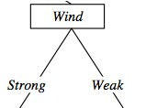
After third steps
Working on Outlook=Rain node:
Gain(S_{rain}, Humidity) = 0.0192
Gain(S_{rain}, Wind) = 0.97 max
Gain(S_{rain}, Temp.) = 0.0192
{D1, D2, D8}
No
{D9, D11}
Yes
{D6, D14}
yes
{D4, D5, D10}
No

Slide 29


Example - 2
 | a1 | a2 | classification
1 | T | T | +
2 | T | T | +
3 | T | F | -
4 | F | F | +
5 | F | T | -
6 | F | T | -
Target Attribute – Classification
Attribute – a1 and a2
Values(a1) = T, F Values(a2) = T, F
Gain(S, A) = Entropy(S) − Σ$\frac{\left|S_{v}\right|}{|S|}$ Entropy(Sv)
Entropy H(X) = – $\frac{P}{P+N}$ log₂ $\frac{P}{P+N}$ – $\frac{N}{P+N}$ log₂ $\frac{N}{P+N}$

Slide 30

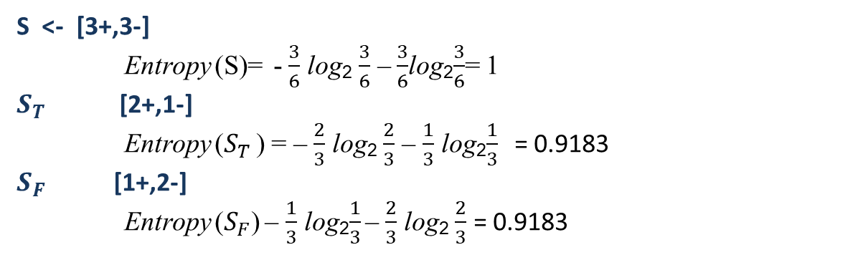

 | a1 | a2 | classification
1 | T | T | +
2 | T | T | +
3 | T | F | -
4 | F | F | +
5 | F | T | -
6 | F | T | -
Attribute – a1
Gain(S, a1) = ?
Values(a1) = T, F
S <- [3+,3-]
Entropy (S)= - $\frac{3}{6}$ log₂ $\frac{3}{6}$ – $\frac{3}{6}$log₂$\frac{3}{6}$= 1
$S_{T}$ [2+,1-]
Entropy ($S_{T}$ ) = – $\frac{2}{3}$ log₂ $\frac{2}{3}$ – $\frac{1}{3}$ log₂$\frac{1}{3}$ = 0.9183
$S_{F}$ [1+,2-]
Entropy ($S_{F}$) – $\frac{1}{3}$ log₂$\frac{1}{3}$ – $\frac{2}{3}$ log₂ $\frac{2}{3}$ = 0.9183
Gain(S, A) = Entropy(S) − Σ$\frac{\left|S_{v}\right|}{|S|}$ Entropy(Sv)
Gain(S, a1) = Entropy(S) − ( $\frac{\left|S_{T}\right|}{|S|}$ Entropy($S_{T}$ ) + $\frac{\left|S_{F}\right|}{|S|}$ Entropy($S_{F}$ ) )
= 0.94 – ($\frac{3}{6}$ ∗ 0.9183 + $\frac{3}{6}$ ∗ 0.9183) = 0.0817

Slide 31
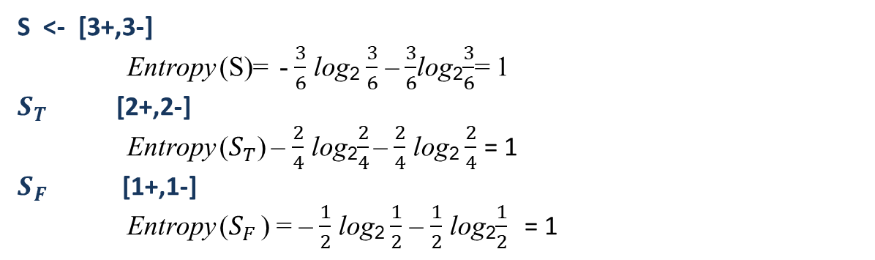

 | a1 | a2 | classification
1 | T | T | +
2 | T | T | +
3 | T | F | -
4 | F | F | +
5 | F | T | -
6 | F | T | -
Attribute – a2
Gain(S, a2) = ?
Values(a2) = T, F
S <- [3+,3-]
Entropy (S)= - $\frac{3}{6}$ log₂ $\frac{3}{6}$ – $\frac{3}{6}$log₂$\frac{3}{6}$= 1
$S_{T}$ [2+,2-]
Entropy ($S_{T}$) – $\frac{2}{4}$ log₂$\frac{2}{4}$ – $\frac{2}{4}$ log₂ $\frac{2}{4}$ = 1
$S_{F}$ [1+,1-]
Entropy ($S_{F}$ ) = – $\frac{1}{2}$ log₂ $\frac{1}{2}$ – $\frac{1}{2}$ log₂$\frac{1}{2}$ = 1
Gain(S, A) = Entropy(S) − Σ$\frac{\left|S_{v}\right|}{|S|}$ Entropy(Sv)
Gain(S, a1) = Entropy(S) − ( $\frac{\left|S_{T}\right|}{|S|}$ Entropy($S_{T}$ ) + $\frac{\left|S_{F}\right|}{|S|}$ Entropy($S_{F}$ ) )
= 1 – ($\frac{4}{6}$ ∗ 1 + $\frac{2}{6}$ ∗ 1) = 0

Slide 32
Gain(S,a1) = 0.0817 Maximum
Gain (s,a2) = 0
a1
T
F
1,2,3
4,5,6
a2
a2
1, 2
3
5,6
4
+
-
-
+

Slide 33
Example - 3
Instances | a1 | a2 | a3 | classification
1 | True | Hot | High | No
2 | True | Hot | High | No
3 | False | Hot | High | Yes
4 | False | Cool | Normal | Yes
5 | False | Cool | Normal | Yes
6 | True | Cool | High | No
7 | True | Hot | High | No
8 | True | Hot | Normal | Yes
9 | False | Cool | Normal | Yes
10 | False | Cool | High | Yes

Slide 34

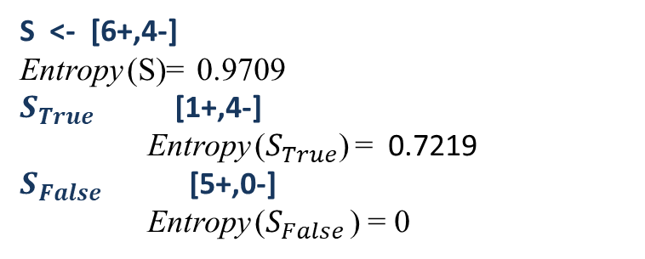
Attribute – a1 (True, False)
Instances | a1 | a2 | a3 | classification
1 | True | Hot | High | No
2 | True | Hot | High | No
3 | False | Hot | High | Yes
4 | False | Cool | Normal | Yes
5 | False | Cool | Normal | Yes
6 | True | Cool | High | No
7 | True | Hot | High | No
8 | True | Hot | Normal | Yes
9 | False | Cool | Normal | Yes
10 | False | Cool | High | Yes
S <- [6+,4-]
Entropy (S)= 0.9709
$S_{True}$ [1+,4-]
Entropy ($S_{True}$) = 0.7219
$S_{False}$ [5+,0-]
Entropy ($S_{False}$ ) = 0
Gain(S, A) = Entropy(S) − Σ$\frac{\left|S_{v}\right|}{|S|}$ Entropy(Sv)
Gain(S, a1) = Entropy(S) − ( $\frac{\left|S_{True}\right|}{|S|}$ Entropy($S_{True}$ ) + $\frac{\left|S_{False}\right|}{|S|}$ Entropy($S_{False}$ ) )
= 0.6099

Slide 35
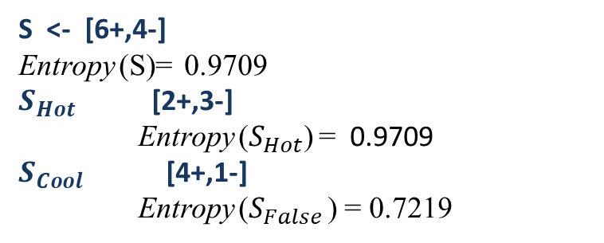
Attribute – a2 ( Hot, cool)
Instances | a1 | a2 | a3 | classification
1 | True | Hot | High | No
2 | True | Hot | High | No
3 | False | Hot | High | Yes
4 | False | Cool | Normal | Yes
5 | False | Cool | Normal | Yes
6 | True | Cool | High | No
7 | True | Hot | High | No
8 | True | Hot | Normal | Yes
9 | False | Cool | Normal | Yes
10 | False | Cool | High | Yes
S <- [6+,4-]
Entropy (S)= 0.9709
$S_{Hot}$ [2+,3-]
Entropy ($S_{Hot}$) = 0.9709
$S_{Cool}$ [4+,1-]
Entropy ($S_{False}$ ) = 0.7219
Gain(S, A) = Entropy(S) − Σ$\frac{\left|S_{v}\right|}{|S|}$ Entropy(Sv)
Gain(S, a2) = Entropy(S) − ( $\frac{\left|S_{Hot}\right|}{|S|}$ Entropy($S_{Hot}$ ) + $\frac{\left|S_{Cool}\right|}{|S|}$ Entropy($S_{Cool}$ ) )
= 0. 1245

Slide 36
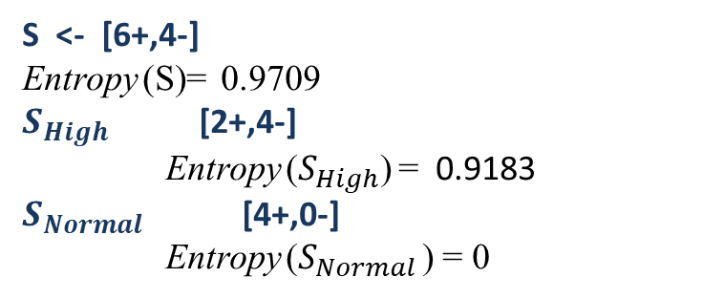
Attribute – a3 ( High, Normal)
Instances | a1 | a2 | a3 | classification
1 | True | Hot | High | No
2 | True | Hot | High | No
3 | False | Hot | High | Yes
4 | False | Cool | Normal | Yes
5 | False | Cool | Normal | Yes
6 | True | Cool | High | No
7 | True | Hot | High | No
8 | True | Hot | Normal | Yes
9 | False | Cool | Normal | Yes
10 | False | Cool | High | Yes
S <- [6+,4-]
Entropy (S)= 0.9709
$S_{High}$ [2+,4-]
Entropy ($S_{High}$) = 0.9183
$S_{Normal}$ [4+,0-]
Entropy ($S_{Normal}$ ) = 0
Gain(S, A) = Entropy(S) − Σ$\frac{\left|S_{v}\right|}{|S|}$ Entropy(Sv)
Gain(S, a3) = Entropy(S) − ( $\frac{\left|S_{Hot}\right|}{|S|}$ Entropy($S_{Hot}$ ) + $\frac{\left|S_{Cool}\right|}{|S|}$ Entropy($S_{Cool}$ ) )
= 0. 4199

Slide 37
Instances | a1 | a2 | a3 | classification
1 | True | Hot | High | No
2 | True | Hot | High | No
3 | False | Hot | High | Yes
4 | False | Cool | Normal | Yes
5 | False | Cool | Normal | Yes
6 | True | Cool | High | No
7 | True | Hot | High | No
8 | True | Hot | Normal | Yes
9 | False | Cool | Normal | Yes
10 | False | Cool | High | Yes
Gain(S, a1) = 0.6099
Gain(S, a2) = 0.1245
Gain(S, a3) = 0.4199
a1
True
False
1,2,6,7,8
3,4,5,9,10
Working on a1=True node:
Gain(S_{True}, a2) = ?
Gain(S_{True}, a3) = ?

Slide 38
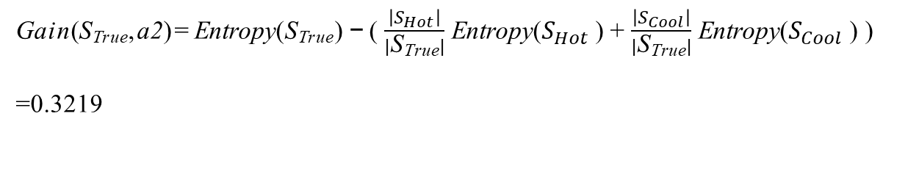
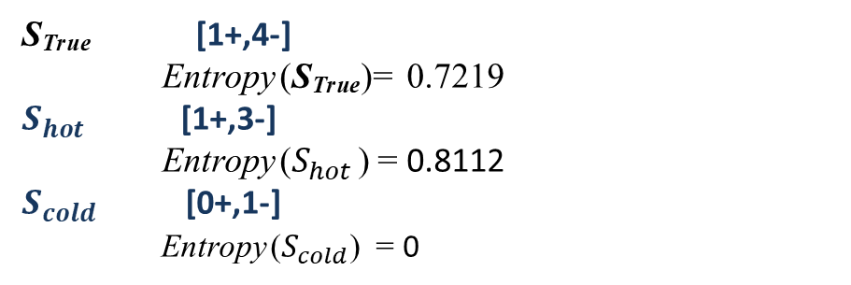
Instances | a2 | a3 | classification
1 | Hot | High | No
2 | Hot | High | No
6 | Cool | High | No
7 | Hot | High | No
8 | Hot | Normal | Yes
Gain(S_{True}, a2) = ? Values(a2) = Hot, Cold
S_{True} [1+,4-]
Entropy (S_{True})= 0.7219
$S_{hot}$ [1+,3-]
Entropy ($S_{hot}$ ) = 0.8112
$S_{cold}$ [0+,1-]
Entropy ($S_{cold}$) = 0
Gain(S_{True}, a2) = Entropy(S_{True}) − ( $\frac{\left|S_{Hot}\right|}{|\text{S}\text{True}|}$ Entropy($S_{Hot}$ ) + $\frac{\left|S_{Cool}\right|}{|\text{S}\text{True}|}$ Entropy($S_{Cool}$ ) )
=0.3219

Slide 39
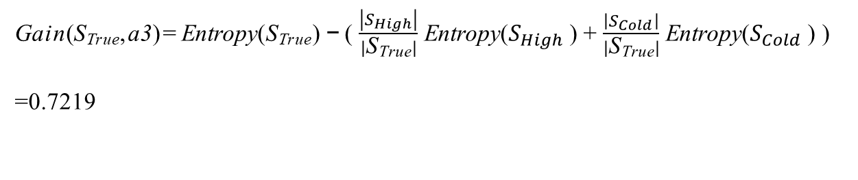
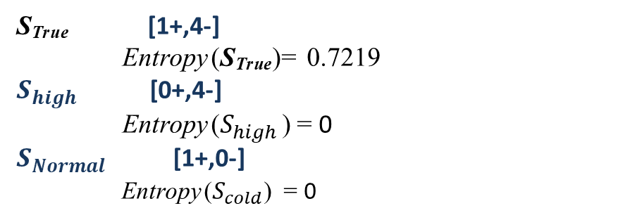
Instances | a2 | a3 | classification
1 | Hot | High | No
2 | Hot | High | No
6 | Cool | High | No
7 | Hot | High | No
8 | Hot | Normal | Yes
Gain(S_{True}, a3) = ? Values(a3) = High, Normal
S_{True} [1+,4-]
Entropy (S_{True})= 0.7219
$S_{high}$ [0+,4-]
Entropy ($S_{high}$ ) = 0
$S_{Normal}$ [1+,0-]
Entropy ($S_{cold}$) = 0
Gain(S_{True}, a3) = Entropy(S_{True}) − ( $\frac{\left|S_{High}\right|}{|\text{S}\text{True}|}$ Entropy($S_{High}$ ) + $\frac{\left|S_{Cold}\right|}{|\text{S}\text{True}|}$ Entropy($S_{Cold}$ ) )
=0.7219

Slide 40
Gain(S_{True}, a2) = 0.3219
Gain(S_{True}, a3) = 0.7219 Maximum
a1
True
False
1,2,6,7,8
3,4,5,9,10
a3
Yes
High
Normal
1,2,6,7
8
No
Yes

Slide 41
Thanks

